Slide 1
Dashboards
Overview of metrics through connected data
Author: Jarne W. Beutnagel (jwb@eaaa.dk)
Subject: Interaction Design
Course: Multimedia Design & Communication
© 2015 Business Academy Aarhus (www.baaa.dk)

Slide 2
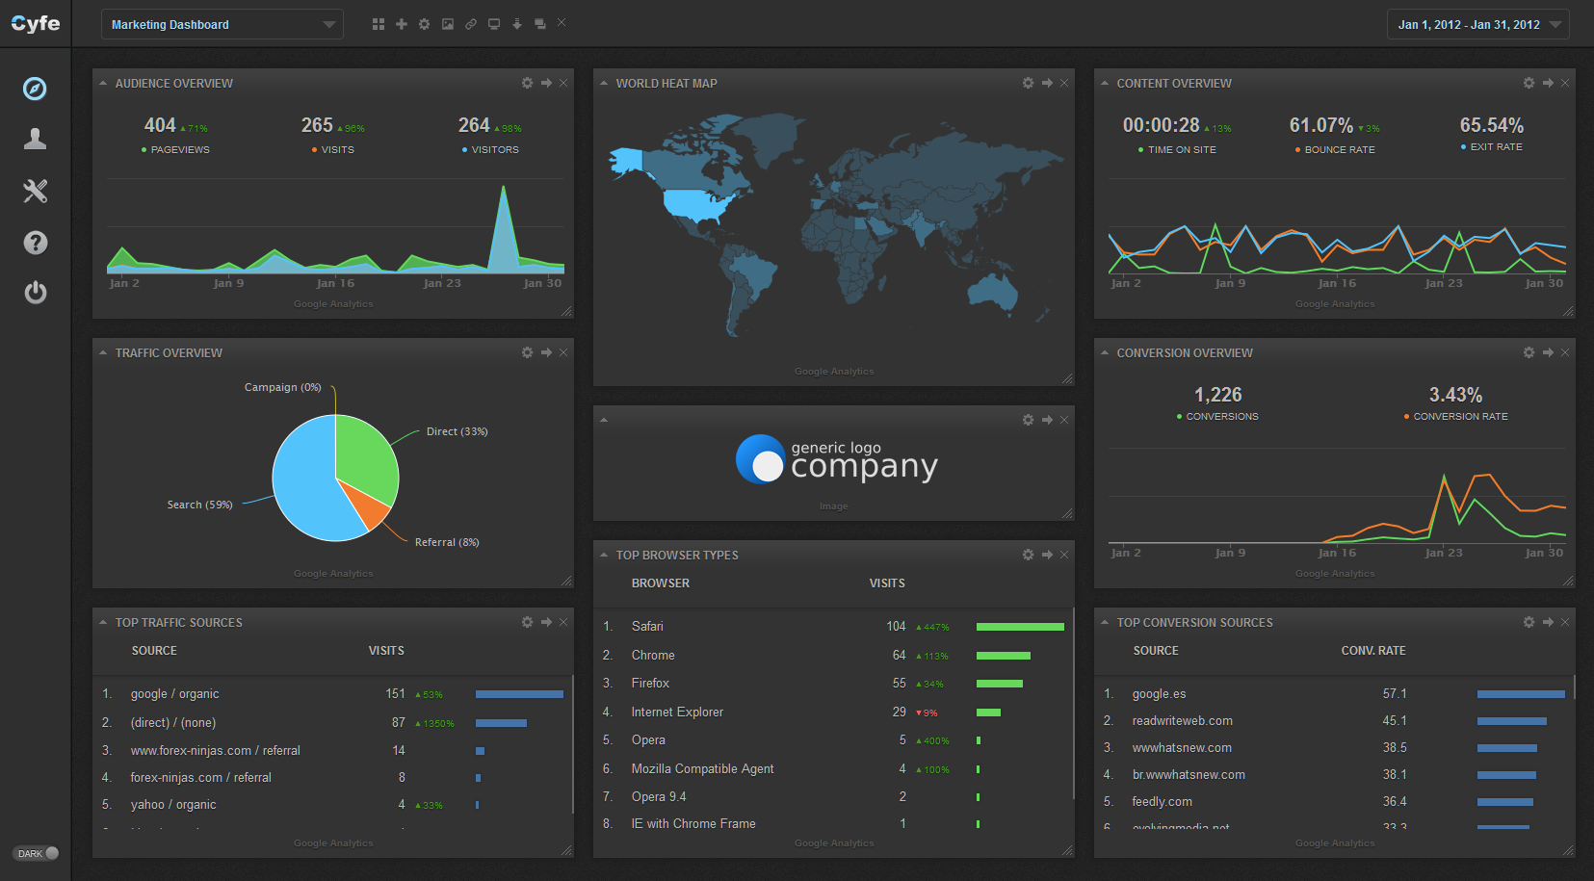

Slide 3
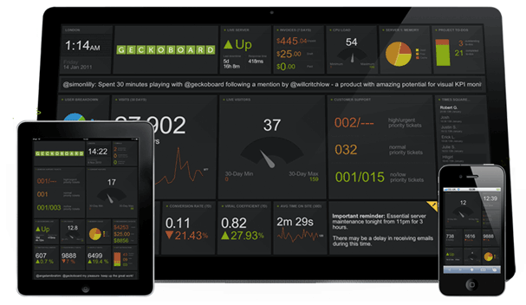

Slide 4


Slide 5
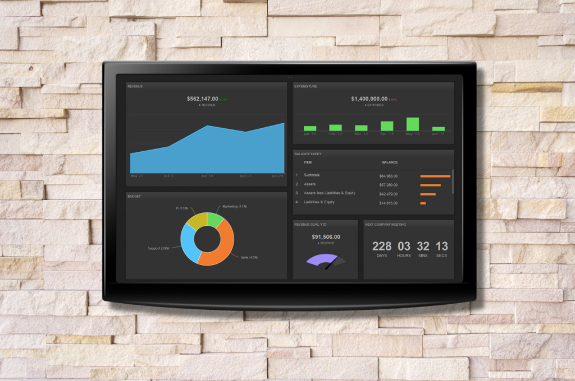

Slide 6
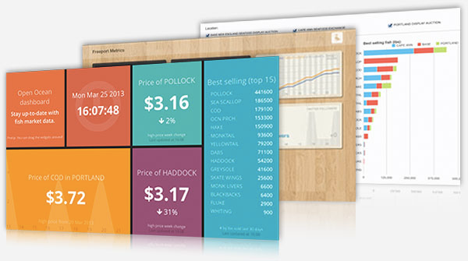

Slide 7
What to use them for

Slide 8
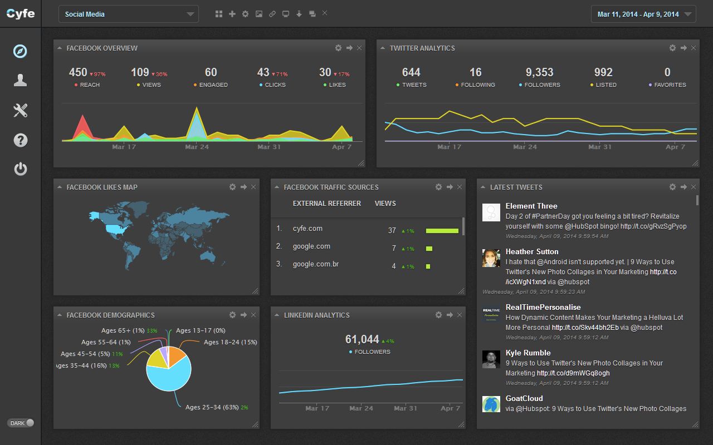
Social Media

Slide 9
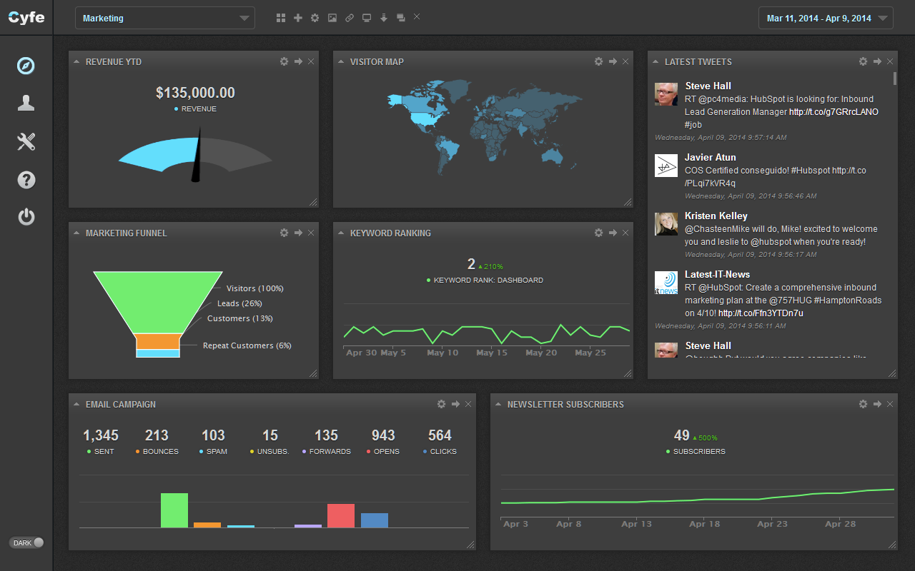
Marketing

Slide 10
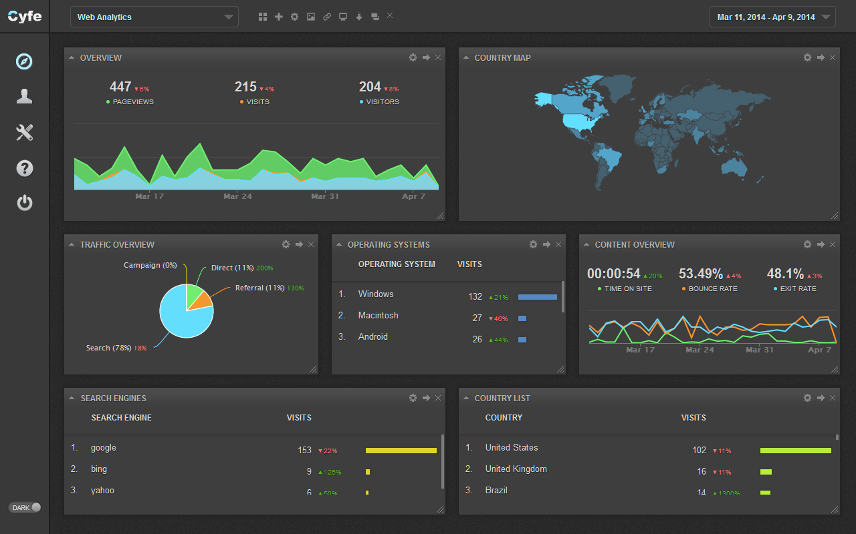
Analytics

Slide 11
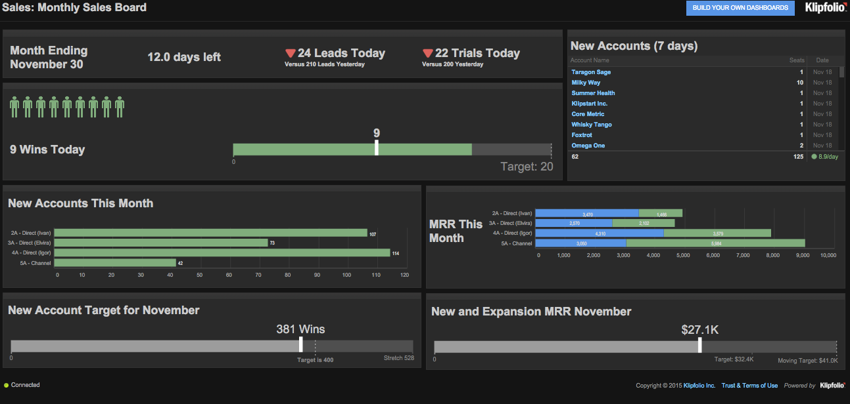
Sales

Slide 12
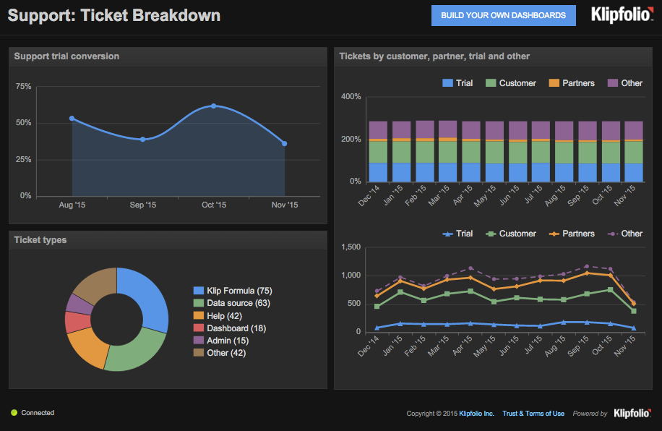
Support Tickets

Slide 13
Get it from…

Slide 14
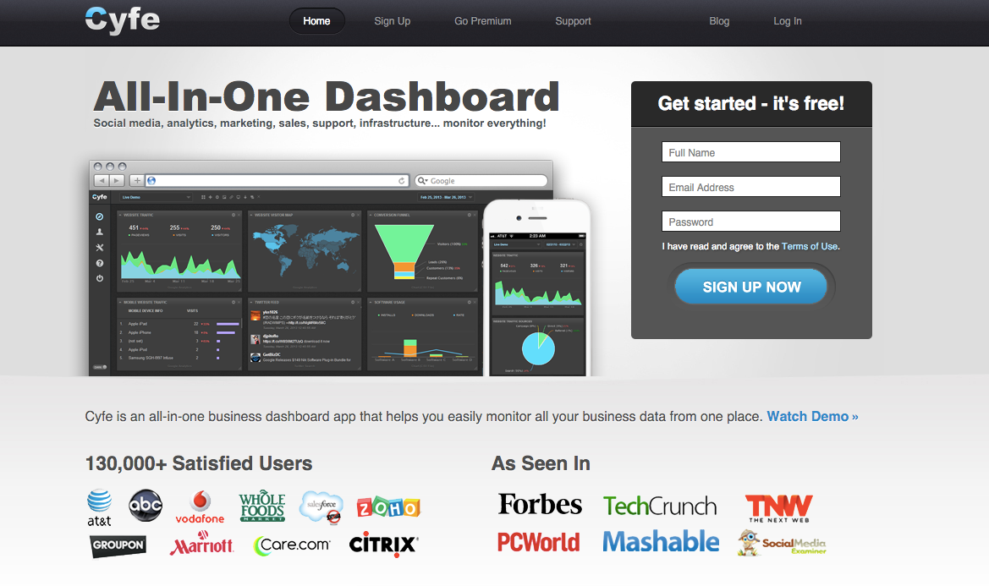
https://www.cyfe.com/

Slide 15
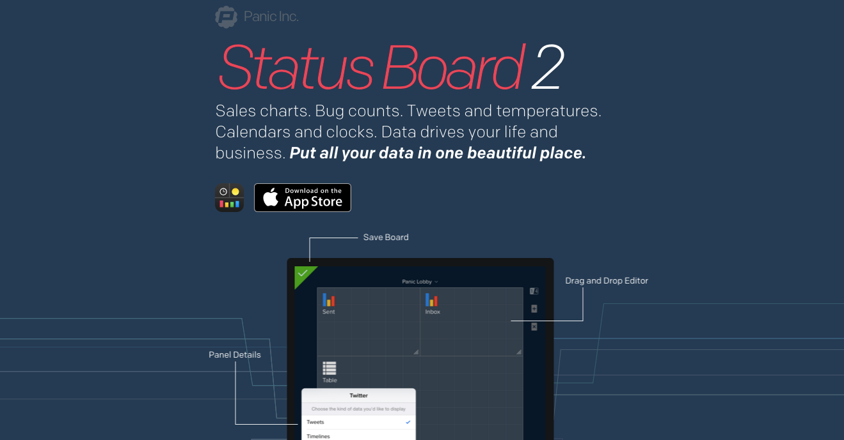
https://panic.com/statusboard/

Slide 16

https://www.geckoboard.com/

Slide 17
How to use them

Slide 18
Connect APIs
(No or little coding)

Slide 19


+

Slide 20
Read more
https://www.cyfe.com/blog/zapier-dashboard-widgets/

Slide 21
Or build your own API

Slide 22
{
"data": [
{
"Date": "20130320",
"Users": "1"
}
],
"onduplicate": {
"Users": "replace"
},
"color": {
"Users": "#52ff7f"
},
"type": {
"Users": "line"
}
}

Slide 23
Inspiration

Slide 24
https://www.cyfe.com/blog/google-analytics-metrics/
http://seo-hacker.com/create-seo-dashboard-cyfe
https://www.panic.com/blog/panic-status-board-2013-edition/

Slide 25
Happy building!
Author: Jarne W. Beutnagel (jwb@eaaa.dk)
Subject: Interaction Design
Course: Multimedia Design & Communication
© 2015 Business Academy Aarhus (www.baaa.dk)

